Slide 1
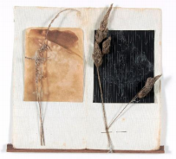
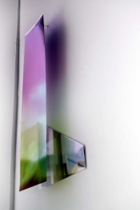
‘Marks of Place’
Siobhán McDonald Kate McElroy

Slide 2
Siobhain McDonald - Currently exhibiting in Uillinn
‘Traces of Air’
She often combines art with scientific knowledge.
To hear her talk about her work with Trinity College: Siobhan McDonald
Name 1 thing that feature in her artwork that suck out carbon from the atmosphere?
Notes:
Answer Ash, volcanoes, plants

Slide 3
Siobhán McDonald is Artist in Residence at the School of Natural Sciences, Trinity College Dublin (2020-2023), working with world-leading research facilities such as The European Space Agency (ESA) and The JRC European Commission to explore ecological concerns. Across research labs, she pursues knowledge to ask questions about the structure and history of the earth, exploring the Anthropocene and the recent consequences of human’s treatment of nature.
Siobhán McDonald Traces of Air 9 January to 20 February 2021, Uillinn West Cork Art’s Centre
Siobhán McDonald's work draws attention to topics dealing with air, breath and atmospheric elements, combining scientific knowledge into her art in a poetic and thoughtful manner.
Traces of Air at Uillinn: West Cork Arts Centre will include new and recent work with plants, roots and charcoal as well as paintings depicting the changing light recorded in forests made earlier this year. Some of these paintings seek to capture the innate environment-sensing capacity of plants, trees and underground networks as witnesses of history. They hold an embodied memory of time, reminding us of how time and memory shift.
This series is very much a work in progress and explores peatlands in Ireland and the idea that everything is connected, by substance, form and history. These ancient landscapes of varied and unique plants that have accumulated over many millions of years.
Key Words
Anthropocene – Is a term used to describe the most recent period in history when human’s started to have a significant impact on the planet’s climate and ecosystems.

Slide 4
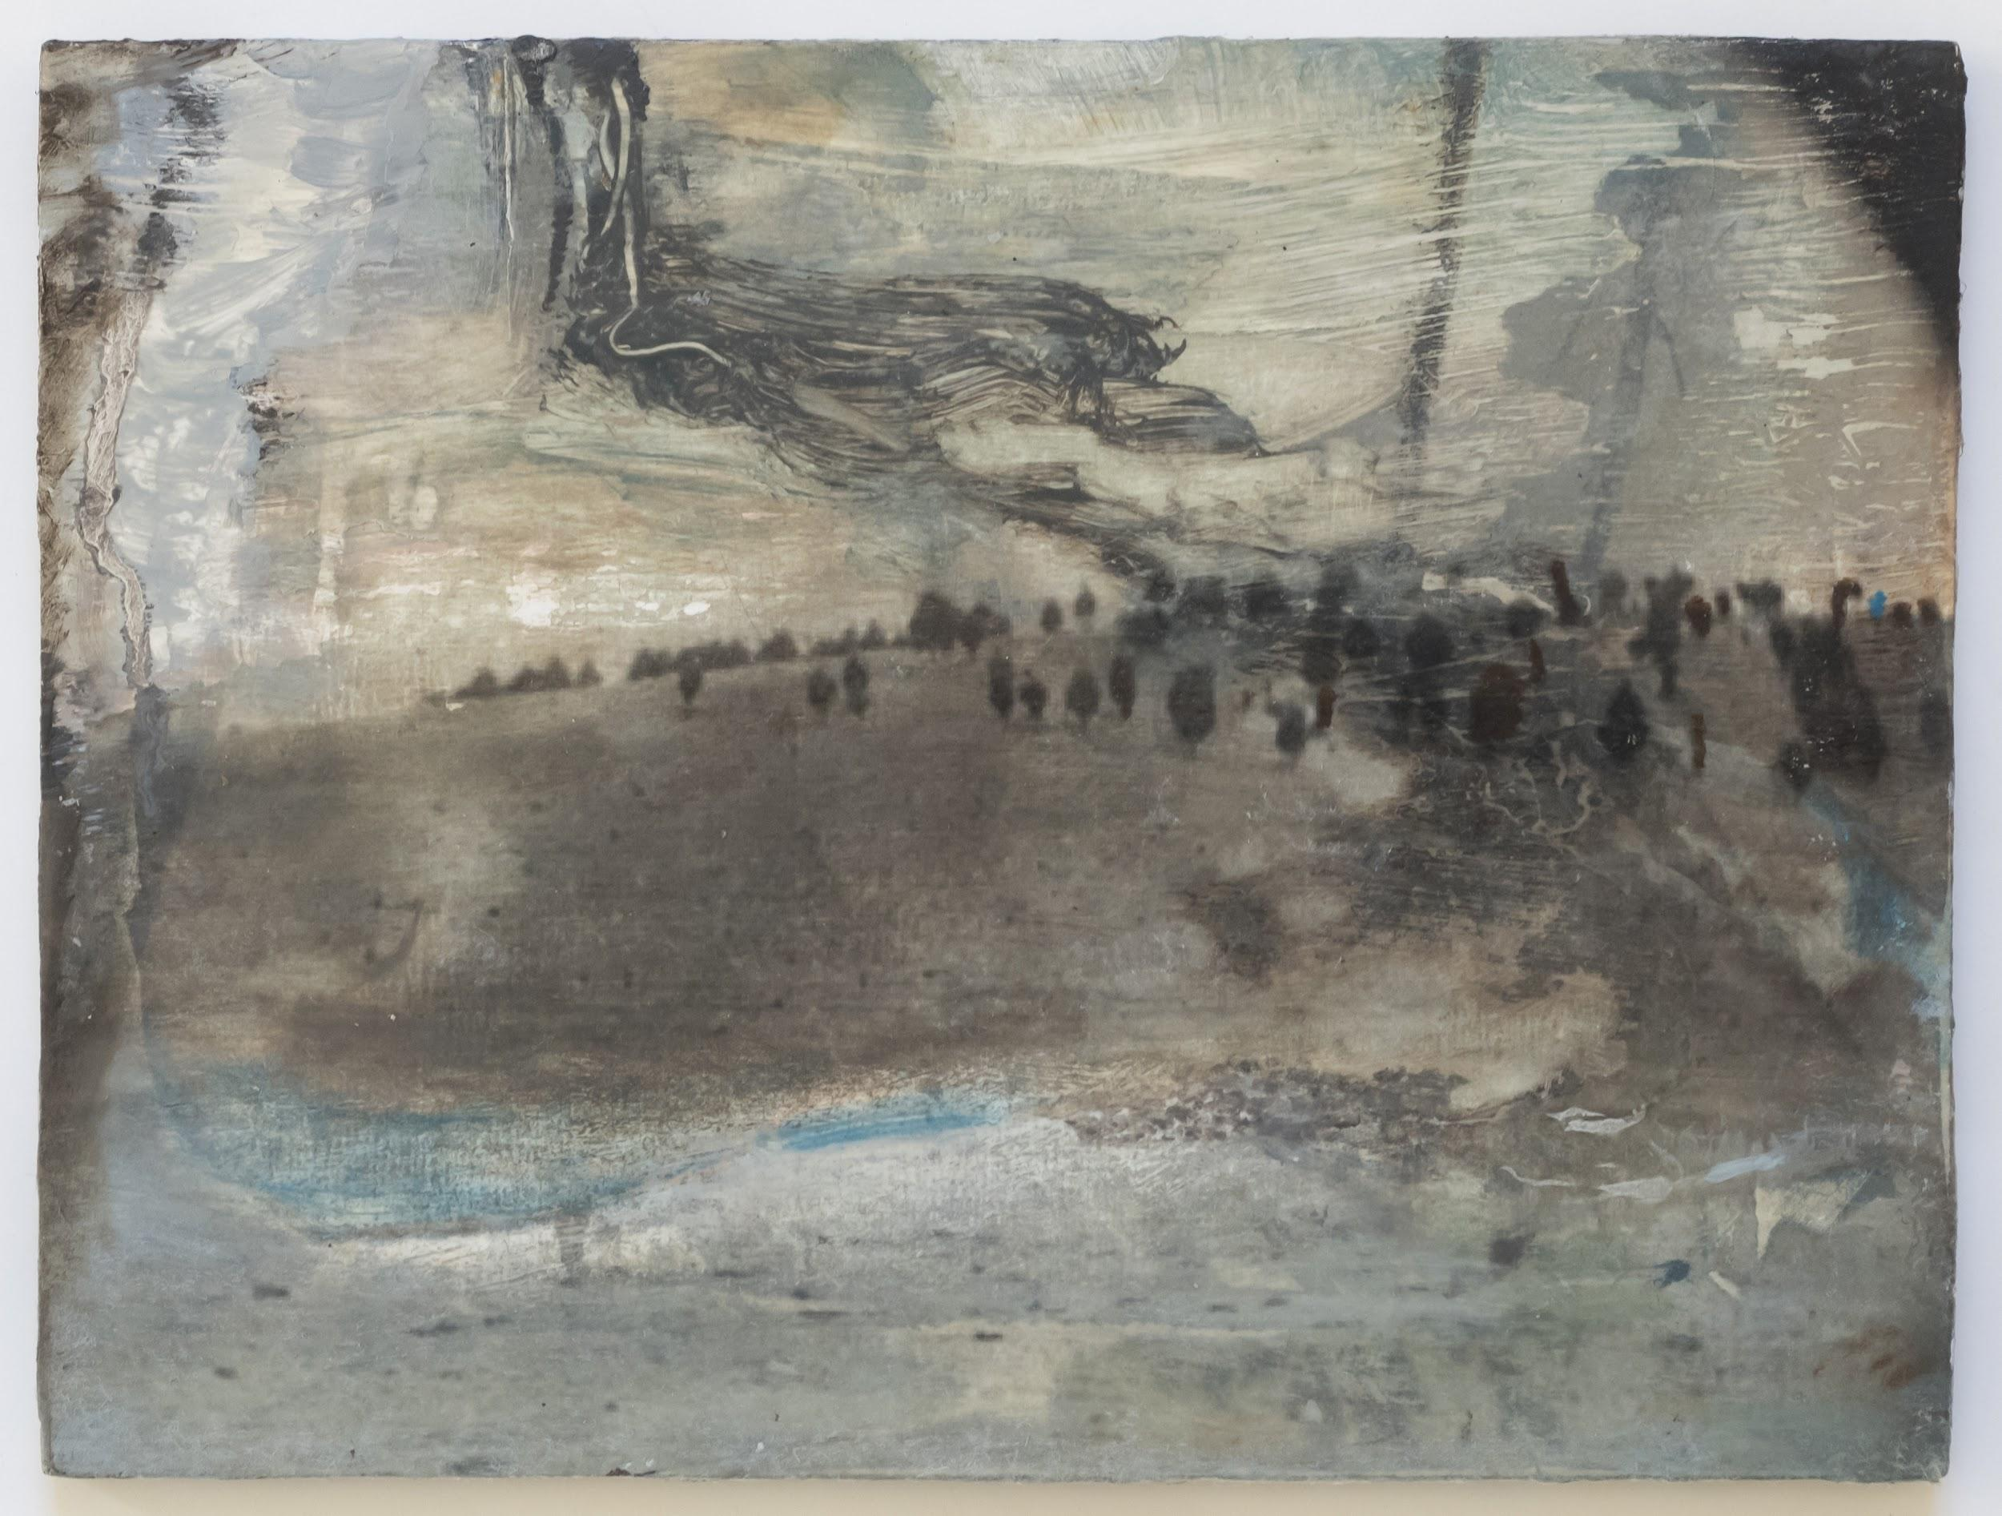
Capture the innate environment-sensing capacity of plants, trees and underground networks as witnesses of history.
They hold an embodied memory of time.
Everything is connected by substance, form and history.
From the series ‘The Sound of trees’

Slide 5
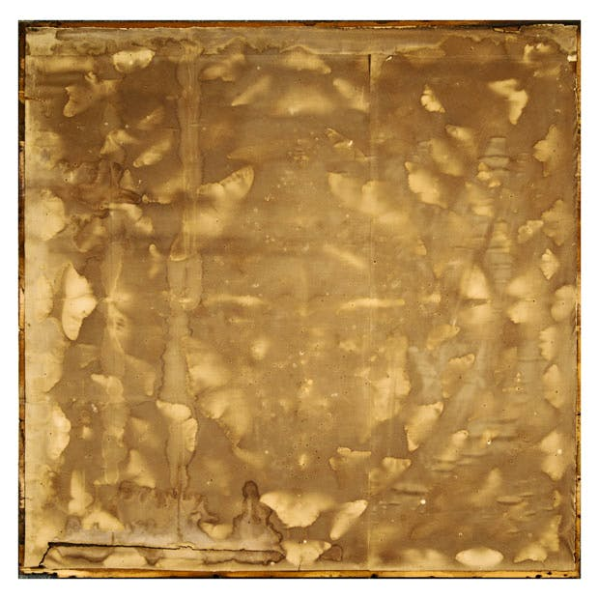
‘Silent Witness’

Slide 6
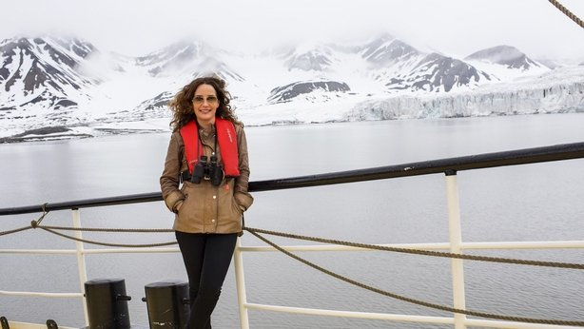
Arctic Expedition
I was captivated by the story of the disappearance of the Franklin ships in 1845, the mythical expedition of two Victorian-era vessels that vanished while searching for the Northwest Passage. I am retracing this territory by developing Unknown Landscapes, a series of oil paintings based on photographic plates from these expeditions. The cameras survived in the permafrost when the ships and crew disappeared into nothingness. The plates carry the melancholy and the magic of those frontier times.

Slide 7
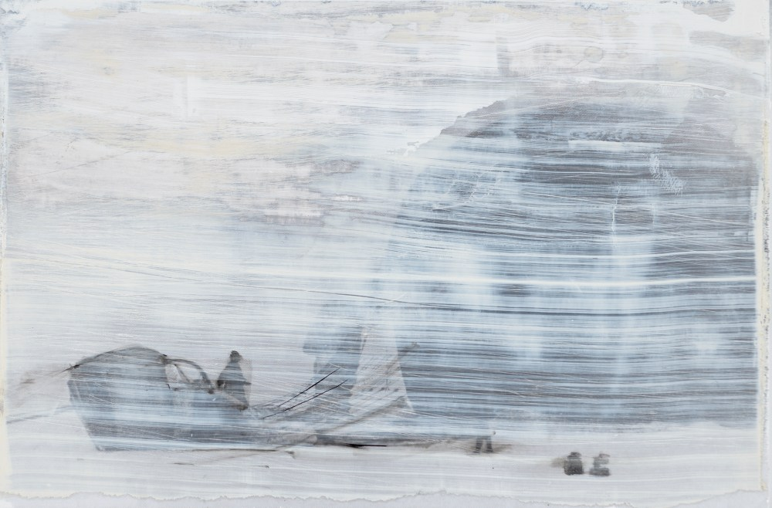
Andrée's Arctic Balloon

Slide 8
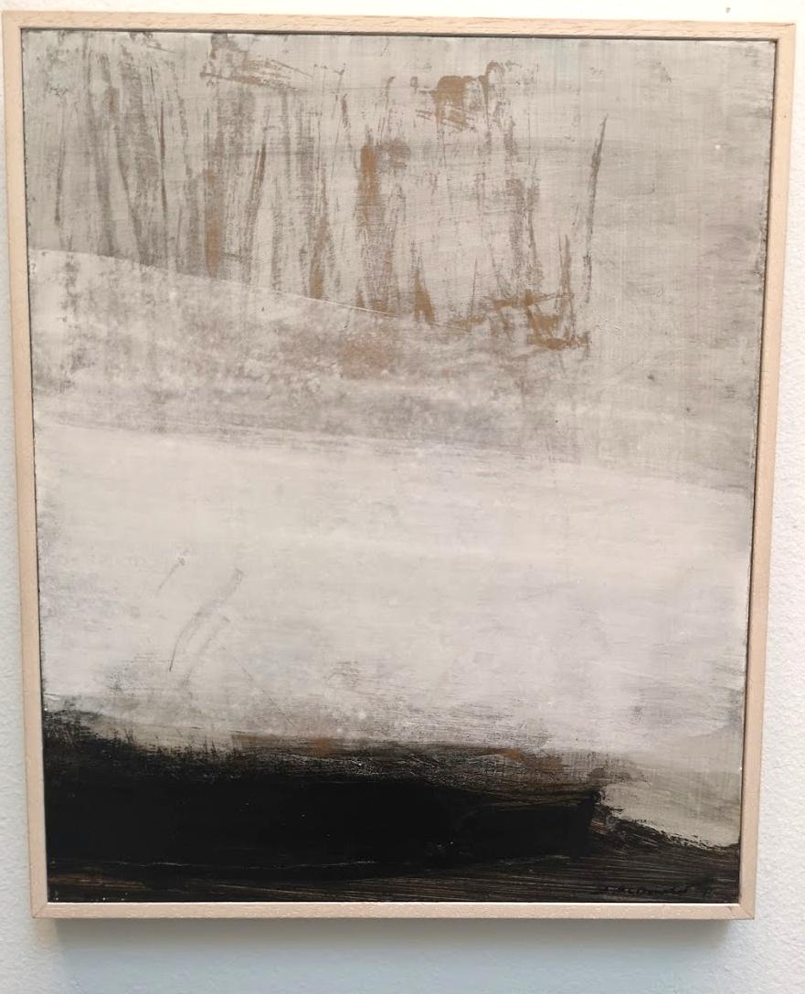
‘Between Worlds’

Slide 9
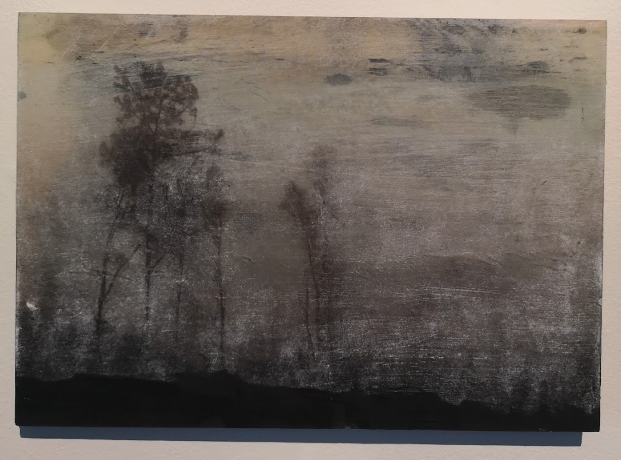
‘Undiscovered
Landscape’

Slide 10
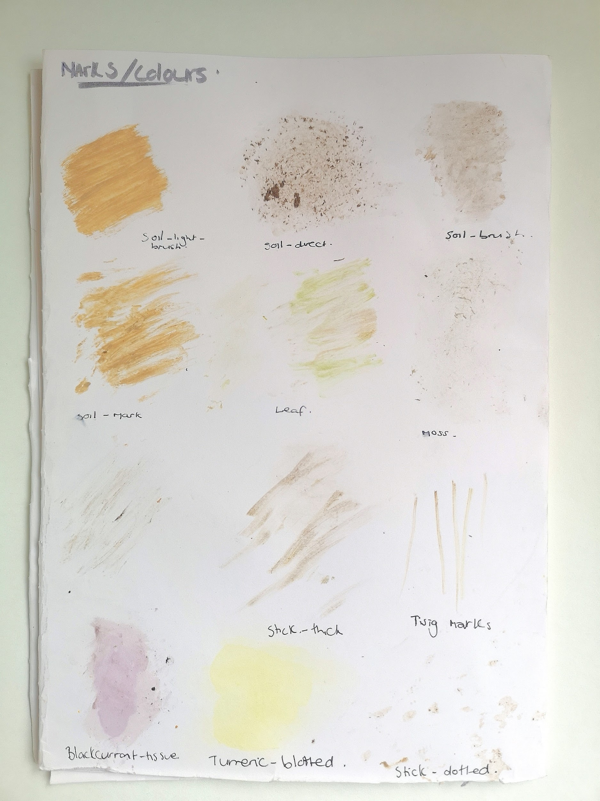
Sketchbooks
Task 1: Make marks and colours with materials and media you find in your surroundings

Slide 11
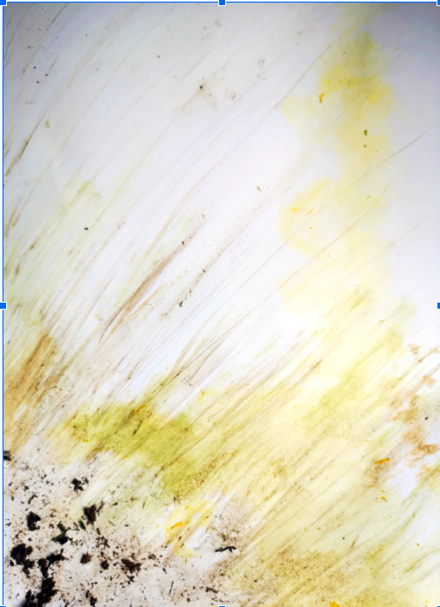
Task 2: Create a landscape using these materials and colours
Example: Spring inspired
Media:
Soil
Twigs
Leaves
Daffodil
Snowdrop

Slide 12
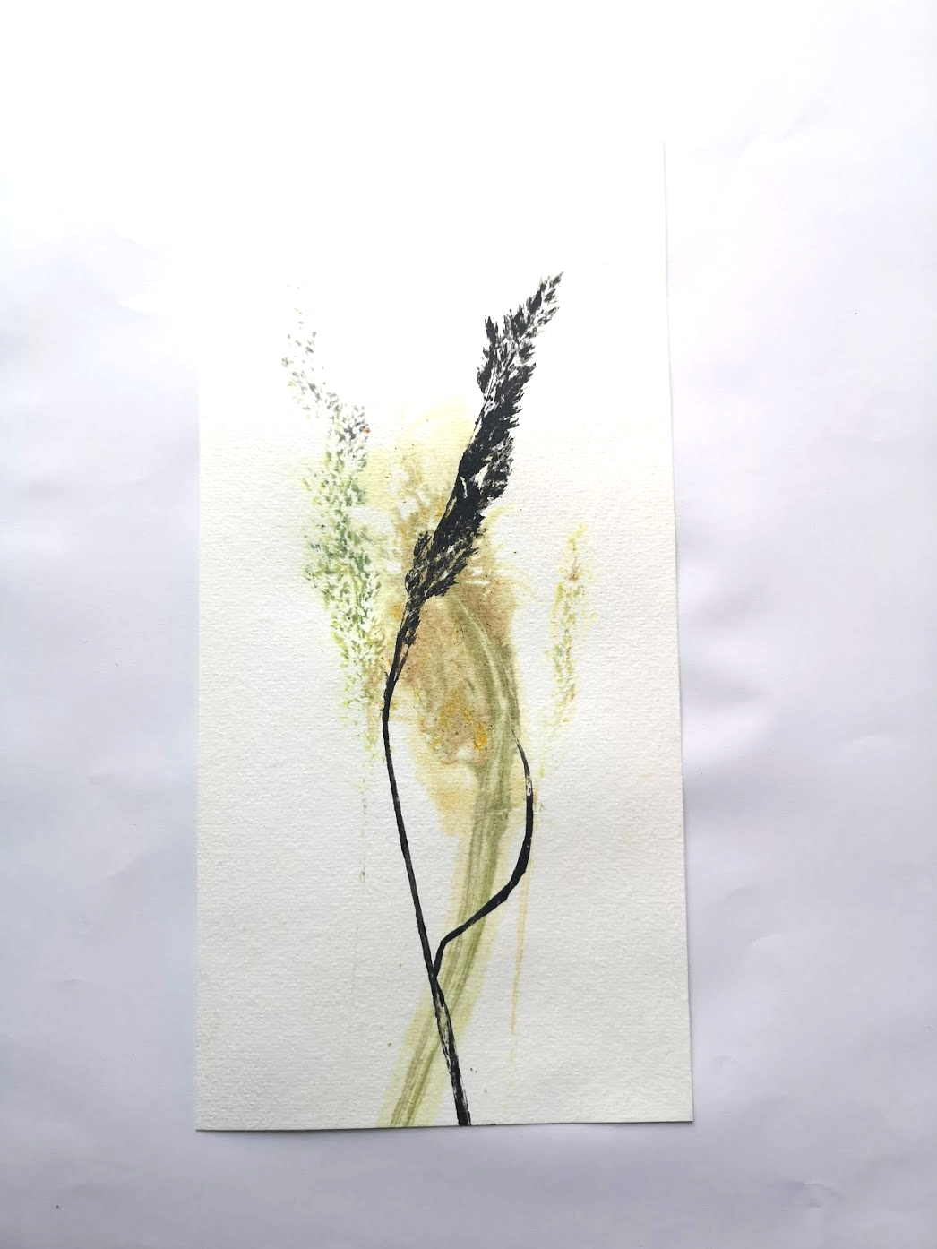
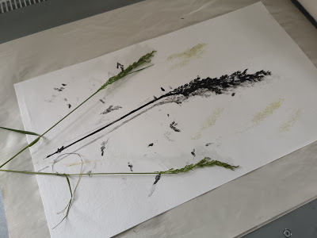

Slide 13
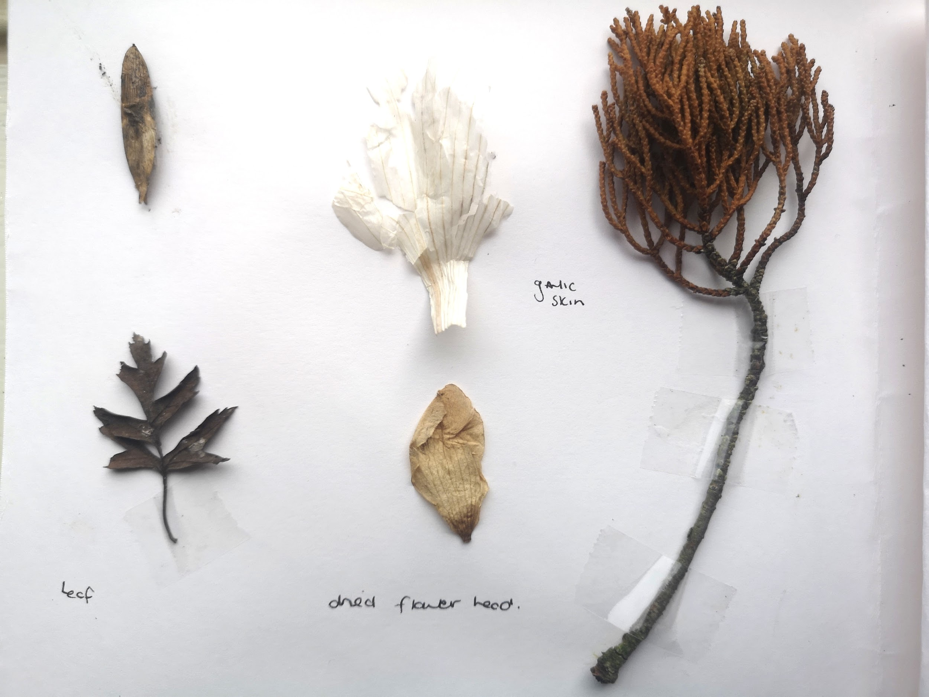
Sketchbook - Task 3 - Collect materials and stick in

Slide 14
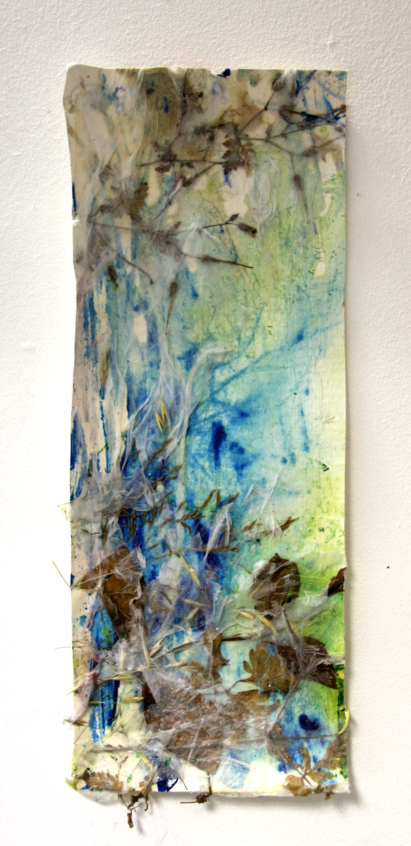
Task 4
Create a landscape using some of these materials

Slide 15
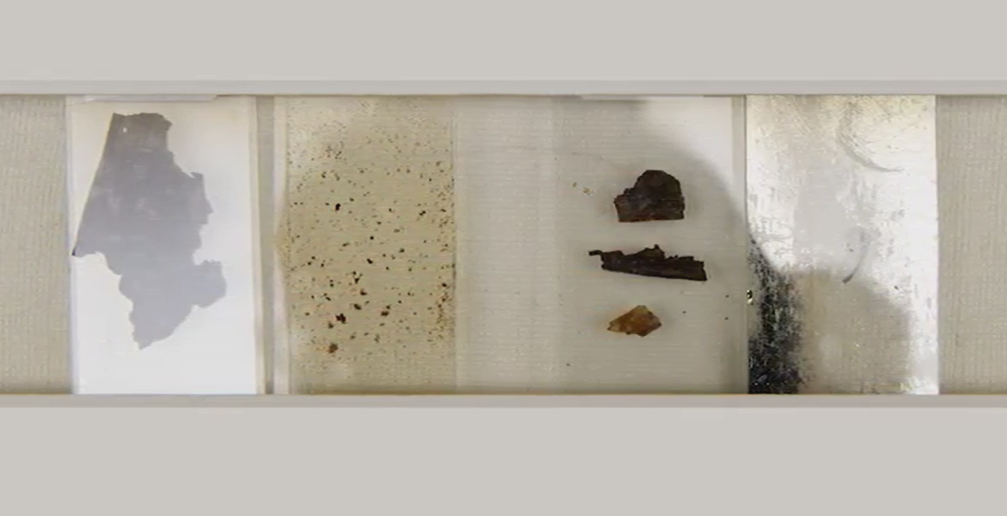
‘Herbarium of breath’ Siobhan McDonald
Collected Ash
and air particles from over Europe, silver, earth minerals and ancient plant fossils
Ash is ground down to make a pigment
The potential of volcanic ash as a carbon sink for atmospheric CO2 is currently under investigation and so the raw materials of the piece embody the idea of ash as a lung for the earth

Slide 16
‘Herbarium of Breath’

Slide 17
Sketchbook Ideas - Exploration
‘The Sound of trees’

Slide 18
‘History of Breath 11’

Slide 19
